Slide 1
Staying a Smoker to Stay Social:
Anxious Smoking:
Social (and other) Stress and The Relationship to Nicotinic Receptors and (possibly) Orexin
Jazmine Yaeger

Slide 2
What you all know about smoking…
Smoking is bad…mmmkay
For your life
Responsible for more than 5 million deaths a year between 1990-2015¹
For your health
Causes cancer – lung, heart, pancreas²…many more…
And other health defects
For your pets^{3,4}
1. Reitsma, M. B., et al. "Smoking prevalence and attributable disease burden in 195 countries and territories, 1990&#x2013;2015: a systematic analysis from the Global Burden of Disease Study 2015." The Lancet 389(10082): 1885-1906.
2. Carbone, D. (1992). "Smoking and cancer." The American journal of medicine 93(1): S13-S17.
3. Reif, J. S., et al. (1992). "Passive smoking and canine lung cancer risk." Am J Epidemiol 135(3): 234-239.
4. Bertone, E. R., et al. (2002). "Environmental tobacco smoke and risk of malignant lymphoma in pet cats." Am J Epidemiol 156(3): 268-273.

Slide 3
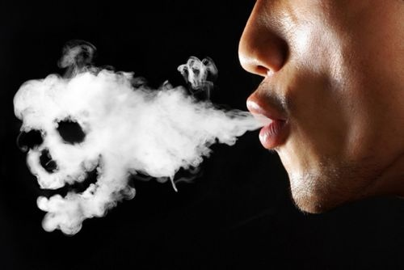
What you may not know about smoking…
Smoking is anxiogenic¹
A smoker needs to maintain a steady level of “normal” (like with other drugs)
Smoking-induced anxiety extends to social contexts²
Why smoke socially?
Young self-described “Social Smokers” use tobacco as frequently as “Smokers”³
1. Parrott, A. C. (1999). "Does cigarette smoking cause stress?" American Psychologist 54(10): 817.
2. Irvine, E. E., et al. (2001). "Development of tolerance to nicotine’s anxiogenic effect in the social interaction test." Brain research 894(1): 95-100.
3. Villanti, A. C., et al. (2017). "Identifying “social smoking” US young adults using an empirically-driven approach." Addictive Behaviors 70: 83-89.

Slide 4
But…
What is the neurophysiological mechanism relating smoking and (social) anxiety?
Can this tell us anything about anxiety in general?
Or social stress resilience?
We shall see…

Slide 5
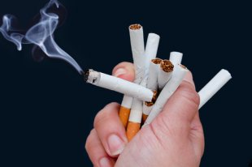
Nicotine
Plant derived molecule
Works as antiherbivore agent
Highly addictive
Binds to cholinergic receptors
Functions as an agonist

Slide 6
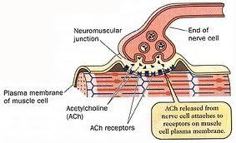
Acetylcholine and It’s Receptors
Abundant neurotransmitter in all organisms
Neuromuscular junction
Central Nervous System
Plasticity, Arousal, Reward, Learning & Memory…

Slide 7
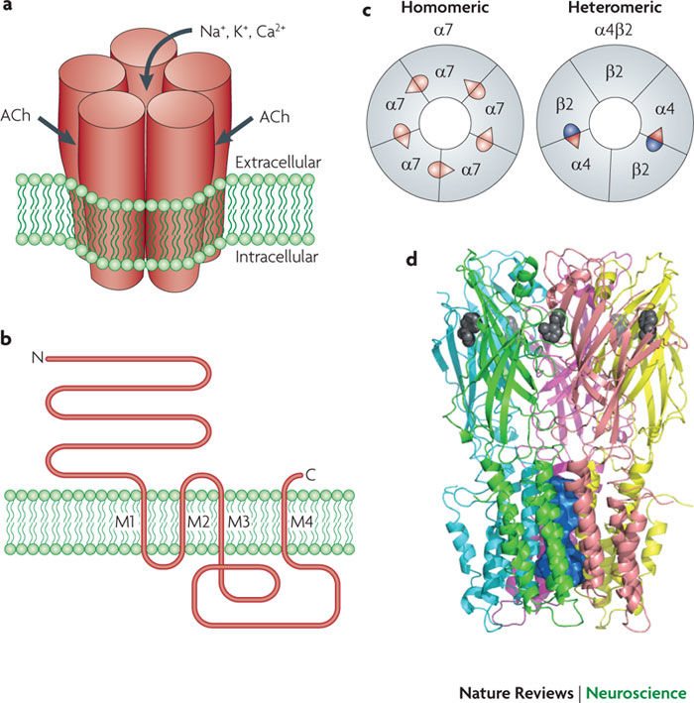
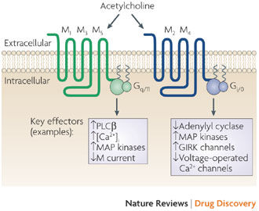
Acetylcholine and It’s Receptors
Nicotinic Receptors (nAChRs)
Ionotropic
Composed of 5 subunits
Neuromuscular
Embryo → 2 x α1, 1 x β1, 1 x γ, 1 x δ
Adult → 2 x α1, 1 x β1, 1 x δ, 1 x ε
Neuronal
12 different subunits – α2-α10 & β2-β4
Homomeric
Heteromeric
Nicotine acts as agonist
Acts as antagonist to α9 and α10 subunits
Muscarinic Receptors (mAChRs)
Metabotropic
7 Transmembrane Regions
5 Classes (M₁-M₅)
M₁, M₃, M₅ → G_{q}
M₂ & M₄ → G_{i/o}
Muscarine acts as agonist
Changeux, J.-P. (2010). "Nicotine addiction and nicotinic receptors: lessons from genetically modified mice." Nat Rev Neurosci 11(6): 389-401.
Wess, J., et al. (2007). "Muscarinic acetylcholine receptors: mutant mice provide new insights for drug development." Nat Rev Drug Discov 6(9): 721-733.

Slide 8
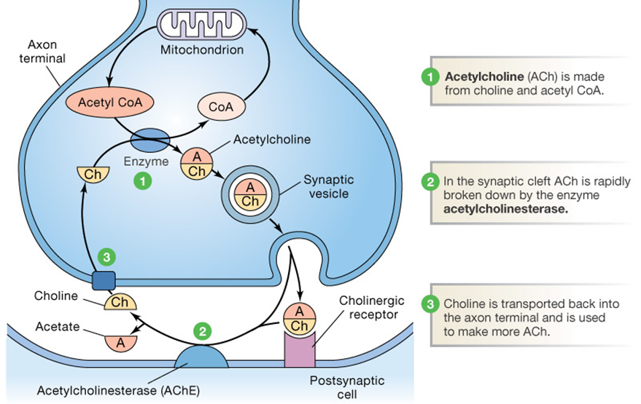
Acetylcholine and It’s Receptors

Slide 9
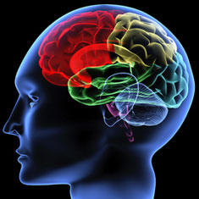
So…
Smoking is associated with anxiogenic effects
And…
nAChRs are important for nicotine action
But…
What is the neurophysiological action?

Slide 10
Hypocretins regulate the anxiogenic-like effects of nicotine and induce reinstatement of nicotine-seeking behavior
Plaza-Zabala et al.

Slide 11
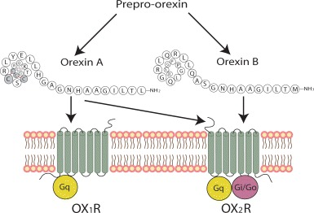
What is hypocretin (orexin)?
Peptide Neurohormone
2 Types From Single Precursor Protein
Orexin A (Hypocretin 1) → 33 aa
Binds Orx₁ & Orx₂ receptors with approximately equal affinity
Orexin B (Hypocretin 2) → 28 aa
Binds Orx₂ receptor more readily
Holland, P. and P. J. Goadsby (2007). "The hypothalamic orexinergic system: pain and primary headaches." Headache: The Journal of Head and Face Pain 47(6): 951-962.

Slide 12
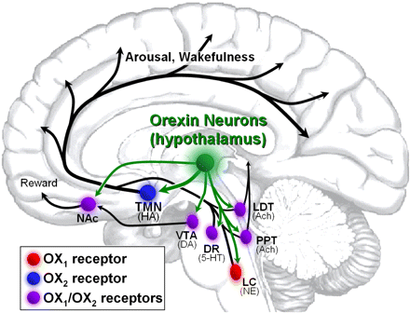
What is hypocretin (orexin)?
Orexin has far-reaching influences on brain activity/behavior
Gotter, A. L., et al. (2012). "International Union of Basic and Clinical Pharmacology. LXXXVI. Orexin receptor function, nomenclature and pharmacology." Pharmacological reviews 64(3): 389-420.

Slide 13
A Brief Introduction to Orexin (continued)
Important role in regulating:
Arousal/Wakefulness^{1,2}
Appetite³
Anxiety⁴
1. Hagan, J. J., et al. (1999). "Orexin A activates locus coeruleus cell firing and increases arousal in the rat." Proceedings of the National Academy of Sciences 96(19): 10911-10916.
2. Kiyashchenko, L. I., et al. (2002). "Release of hypocretin (orexin) during waking and sleep states." The journal of neuroscience 22(13): 5282-5286.
3. Sakurai, T., et al. (1998). "Orexins and orexin receptors: a family of hypothalamic neuropeptides and G protein-coupled receptors that regulate feeding behavior." Cell 92(4): 573-585.
4. Johnson, P. L., et al. (2010). "A key role for orexin in panic anxiety." Nature medicine 16(1): 111-115.

Slide 14
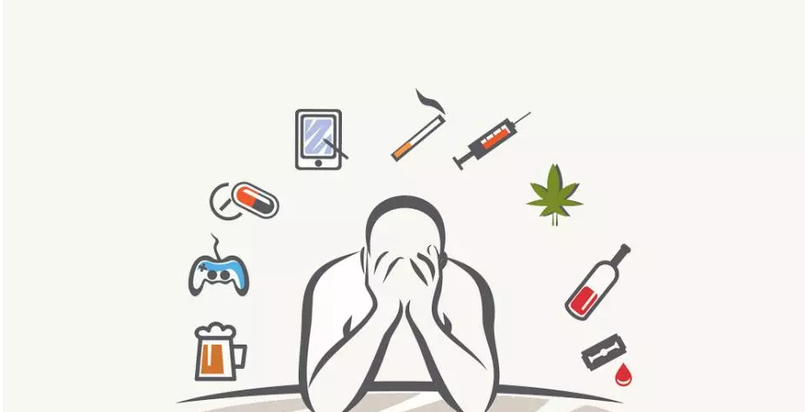
What is hypocretin (orexin)?
Important in disorders:
Obesity¹
Narcolepsy²
Addiction³
1. Kotz, C., et al. (2012). "Brain orexin promotes obesity resistance." Annals of the New York Academy of Sciences 1264(1): 72-86.
2. Siegel, J., et al. (2001). "A brief history of hypocretin/orexin and narcolepsy." Neuropsychopharmacology 25(5): S14-S20.
3. Aston-Jones, G., et al. (2009). "Role of lateral hypothalamic orexin neurons in reward processing and addiction." Neuropharmacology 56: 112-121.

Slide 15
What is hypocretin (orexin)?
Why might orexin be associated with anxiety/depression?
Activates transmitters involved in arousal/stress response¹
Corticotripin Releasing Factor (CRF)
Vasopresson (AVP)
What happens during anxiety/depression?
Disrupted sleep²
Appetite disturbances³
Loss of energy/drive
Hmmm…
Winsky-Sommerer, R., et al. (2004). "Interaction between the corticotropin-releasing factor system and hypocretins (orexins): a novel circuit mediating stress response." Journal of Neuroscience 24(50): 11439-11448.
Breslau, N., et al. (1996). "Sleep disturbance and psychiatric disorders: a longitudinal epidemiological study of young adults." Biological psychiatry 39(6): 411-418.
Leckman, J. F., et al. (1984). "Appetite disturbance and excessive guilt in major depression: use of family study data to define depressive subtypes." Archives of general psychiatry 41(9): 839-844.

Slide 16
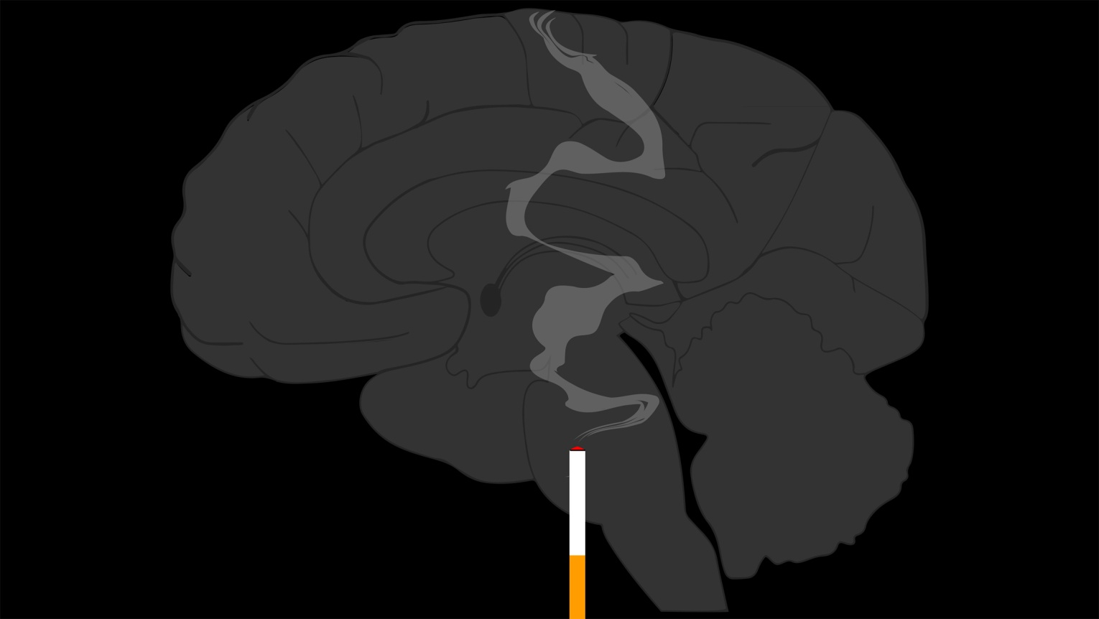
What is hypocretin (orexin)?
Is orexin involved in the “behavioral and biochemical processes underlying nicotine-induced anxiety-like responses?”

Slide 17
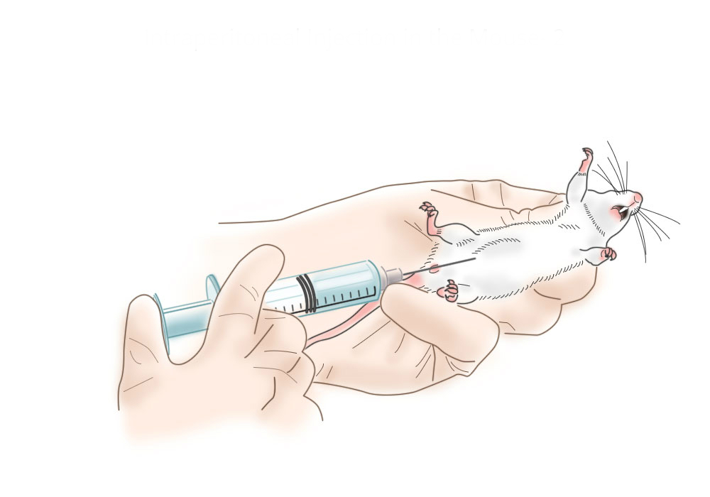
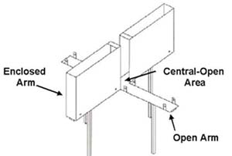
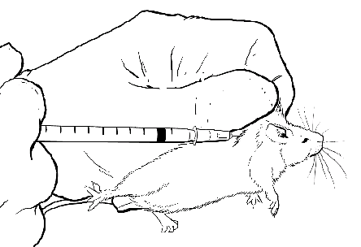
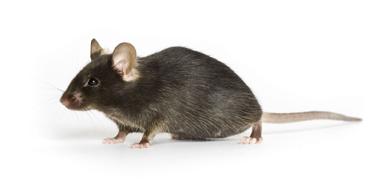
Methods
30 min
SB334867 (5 ml/kg)
Vehicle
Preprohypocretin KO
Nicotine (0.80 ml/kg)
Saline

Slide 18
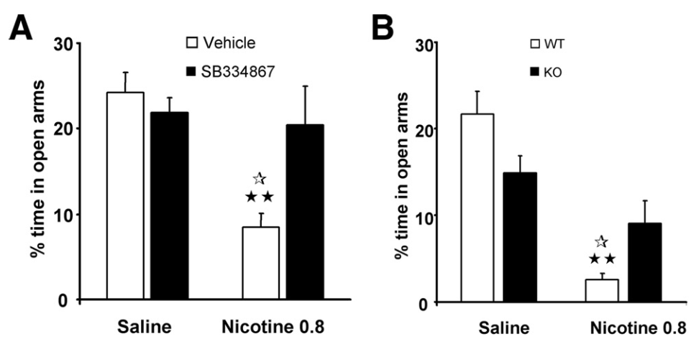
Results
Orexin involved in nicotine-associated anxious behavior in EPM?
P < 0.05
P < 0.01
P < 0.05
P < 0.01

Slide 19
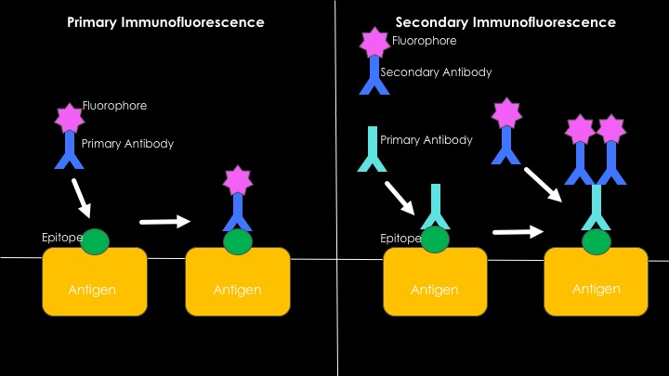
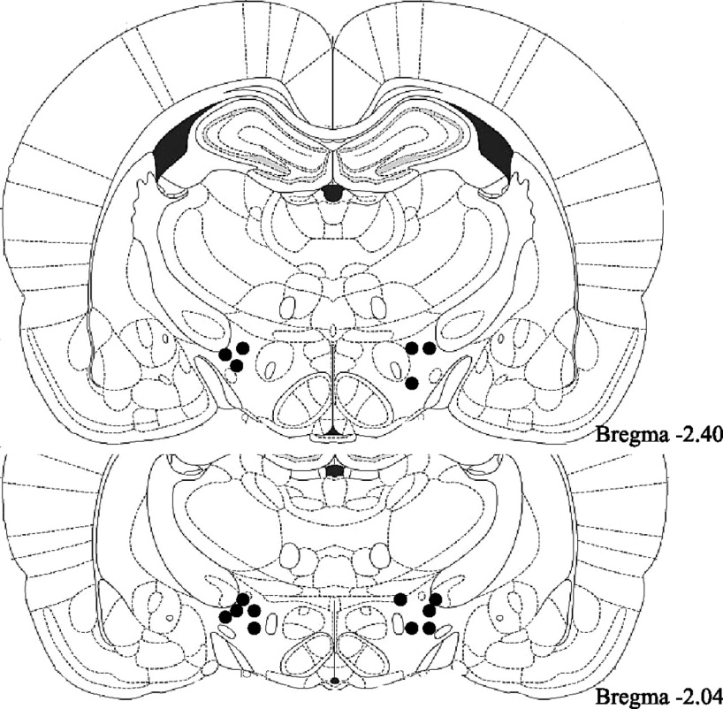
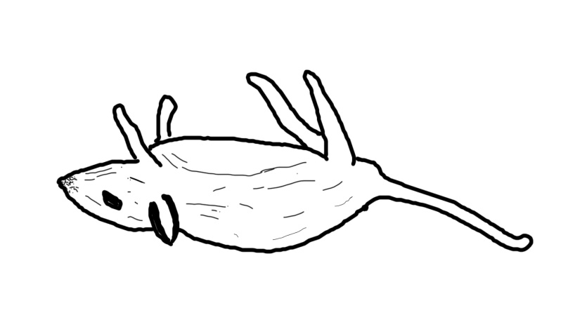
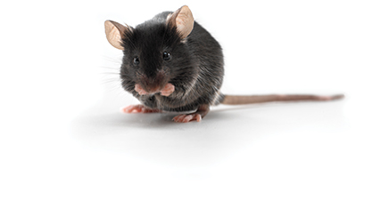
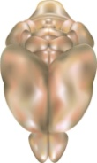
Methods
30 μm
Szentirmai, E. and J. M. Krueger (2006). "Central administration of neuropeptide Y induces wakefulness in rats." American Journal of Physiology - Regulatory, Integrative and Comparative Physiology 291(2): R473.

Slide 20
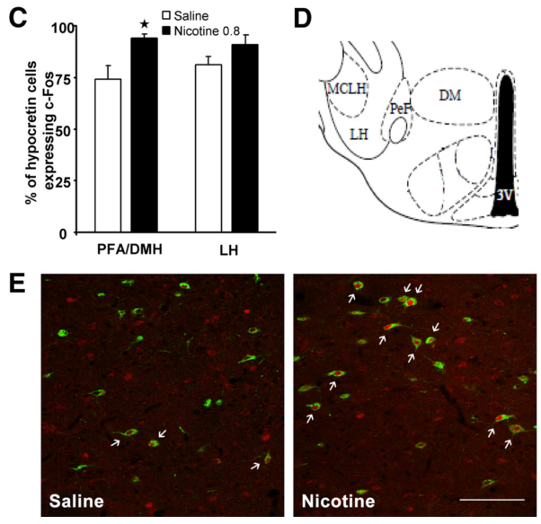
Results
Orexin cells activated during nicotine administration?
P < 0.05

Slide 21
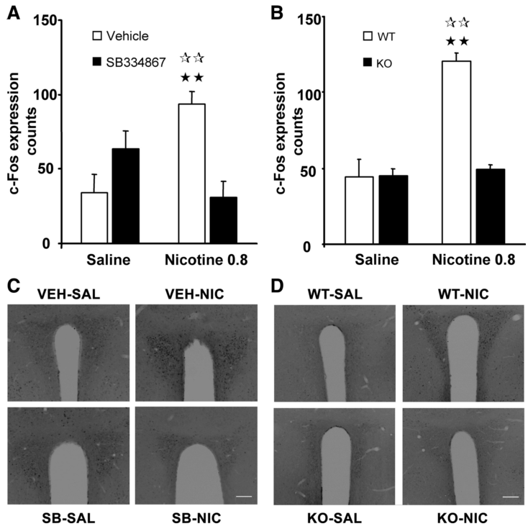
Results
Orexin cells modulate nicotine-associated activation of the PVN?
P < 0.01
P < 0.01
P < 0.01
P < 0.01

Slide 22
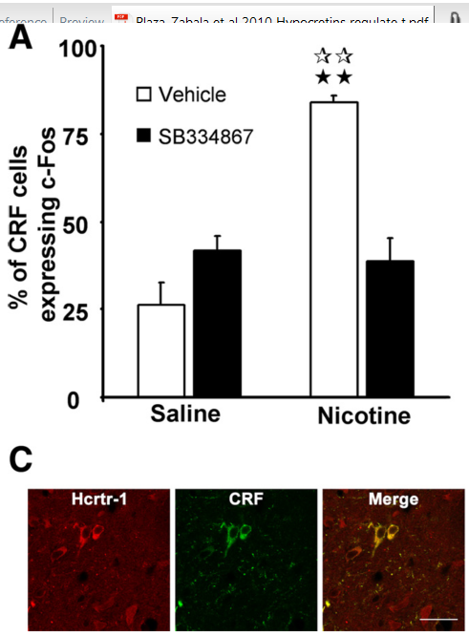
Results
In the PVN, is CRF activity after nicotine dependent on orexin?
P < 0.01
P < 0.01

Slide 23
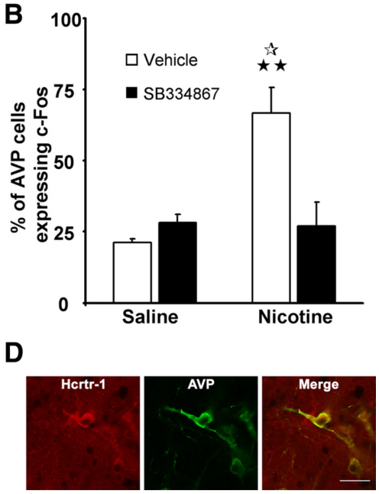
Results
In the PVN, is AVP activity after nicotine dependent on orexin?
P < 0.05
P < 0.01

Slide 24
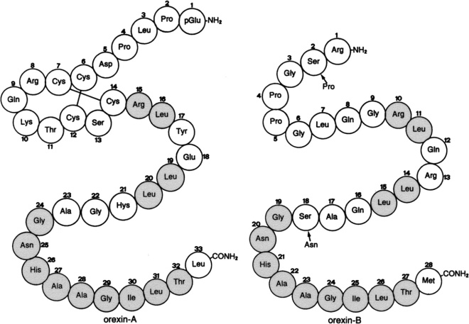
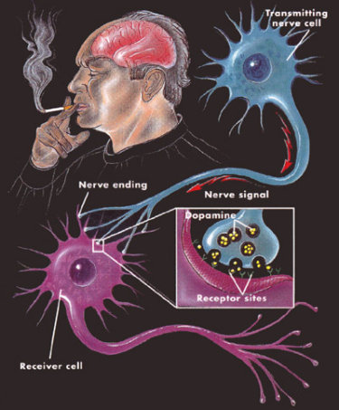
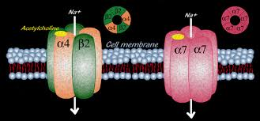
So…
Orexin is important for the anxiogenic effects of nicotine…
But…
Aren’t nAChRs likely involved?
And…
How might the neurophysiology be organized?

Slide 25
Filling some gaps…
Nicotine induces ACh and Glu release onto orexinergic cells in the hypothalamus¹
Orexin cells are directly depolarized by ACh²
Orexin neurons project to cholinergic cells in the basal forebrain³, septohippocampal area⁴, pedunculopontine nucleus (PPT), and laterodorsal tegmental nucleus (LDT) ⁵
Glu
ACh
Nicotine
Orx
ACh
Septohippocampal Area
PPT/LDT
Basal Forebrain
1. Pasumarthi, R. K. and J. Fadel (2010). "Stimulation of lateral hypothalamic glutamate and acetylcholine efflux by nicotine: implications for mechanisms of nicotine‐induced activation of orexin neurons." Journal of neurochemistry 113(4): 1023-1035.
2. Yamanaka, A., et al. (2003). "Regulation of orexin neurons by the monoaminergic and cholinergic systems." Biochemical and Biophysical Research Communications 303(1): 120-129.
3. Eggermann, E., et al. (2001). "Orexins/hypocretins excite basal forebrain cholinergic neurones." Neuroscience 108(2): 177-181.
4. Wu, M., et al. (2004). "Hypocretin/orexin innervation and excitation of identified septohippocampal cholinergic neurons." Journal of Neuroscience 24(14): 3527-3536.
5. Sakurai, T. (2007). "The neural circuit of orexin (hypocretin): maintaining sleep and wakefulness." Nature Reviews Neuroscience 8(3): 171-181.

Slide 26
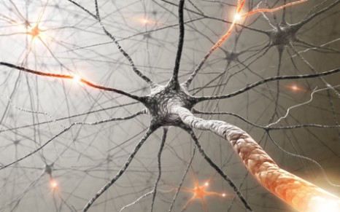
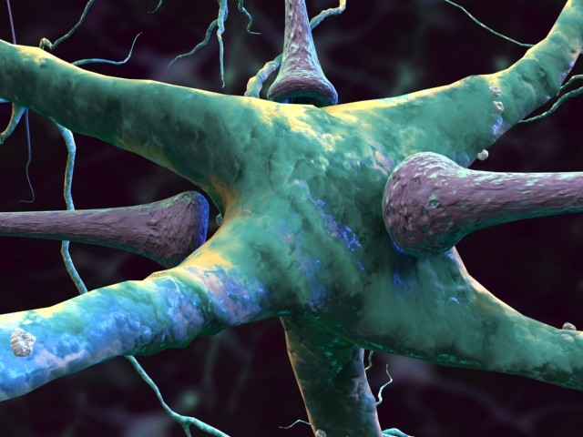
So…
Orexinergic and cholinergic systems are related through circuitry
But…
What is happening at the receptor level?

Slide 27
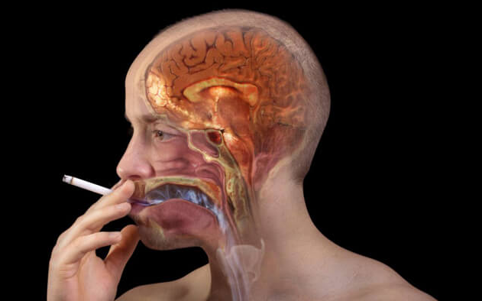
β2 subunit containing acetylcholine receptors mediate nicotine withdrawal deficits in the acquisition of contextual fear conditioning
Portugal, Kenny, & Gould

Slide 28
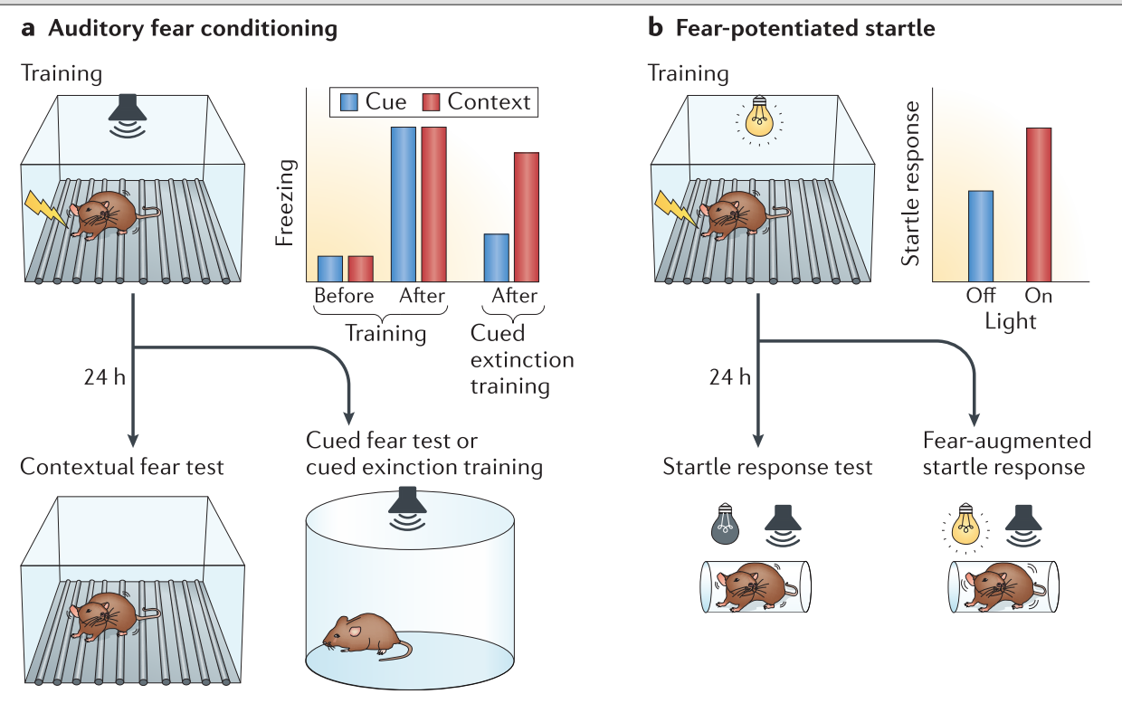
A brief overview of fear conditioning
Tovote, P., et al. (2015). "Neuronal circuits for fear and anxiety." Nature Reviews. Neuroscience 16(6): 317.

Slide 29
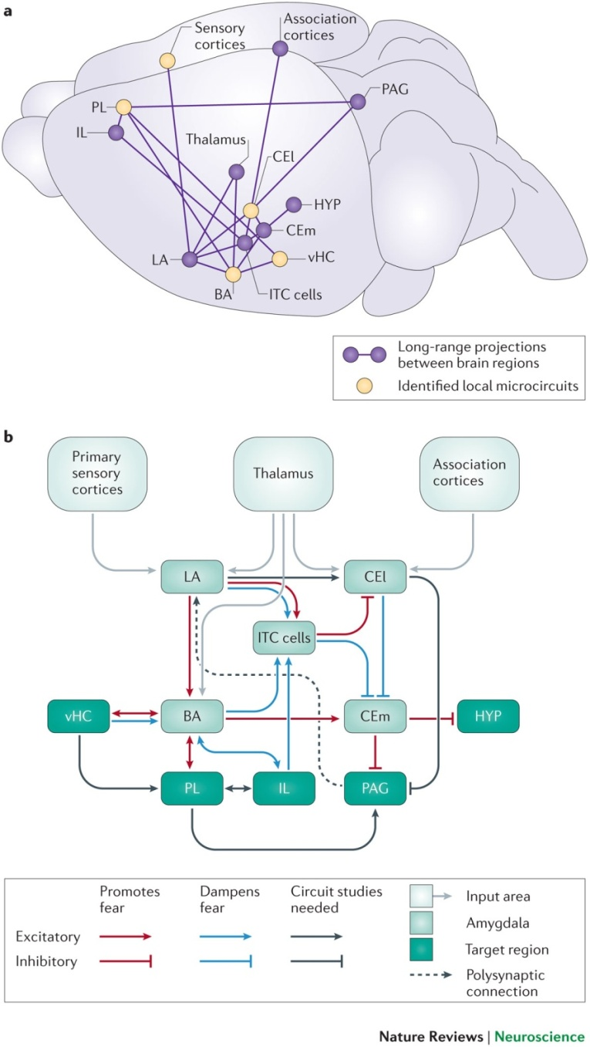
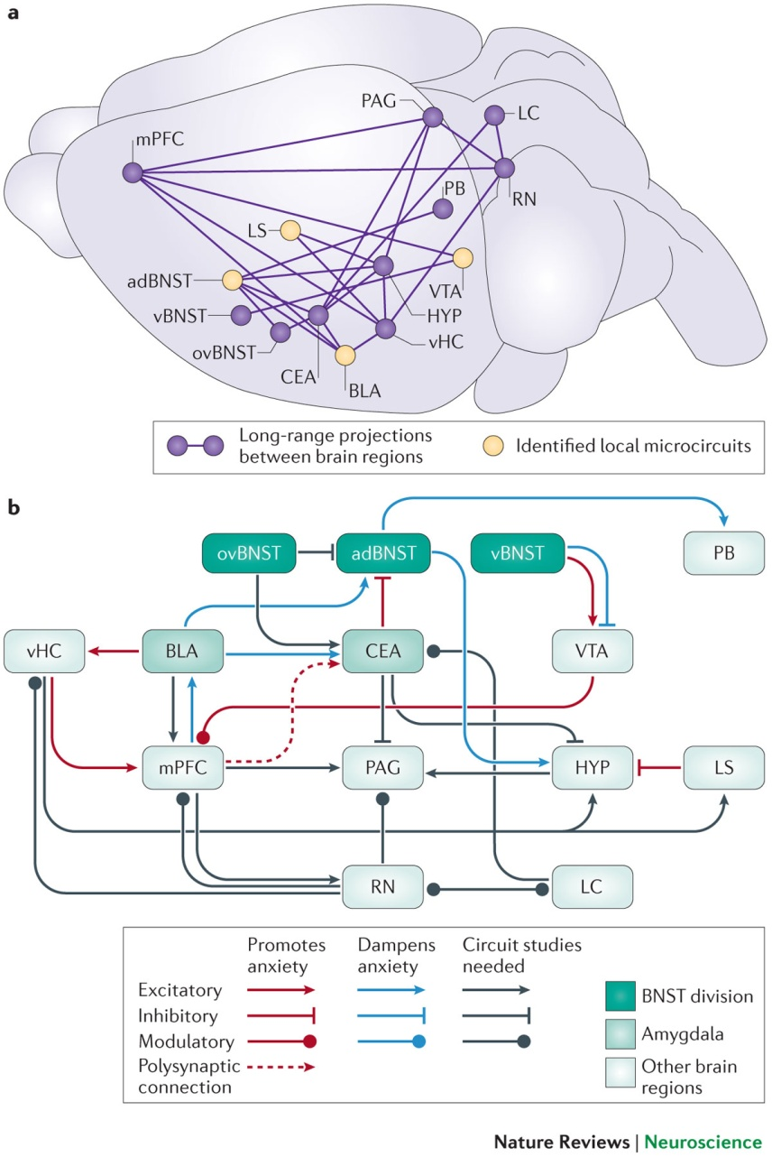
A brief overview of fear conditioning
Fear Circuitry
Anxiety Circuitry
Tovote, P., et al. (2015). "Neuronal circuits for fear and anxiety." Nature Reviews. Neuroscience 16(6): 317.

Slide 30
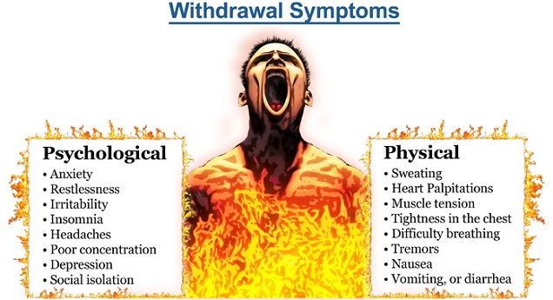
Withdrawal
Loaded with symptoms
Cravings
Irritability
Trouble Sleeping
Hunger or Weight Gain
Depression and Anxiety
Orexin at work again?

Slide 31
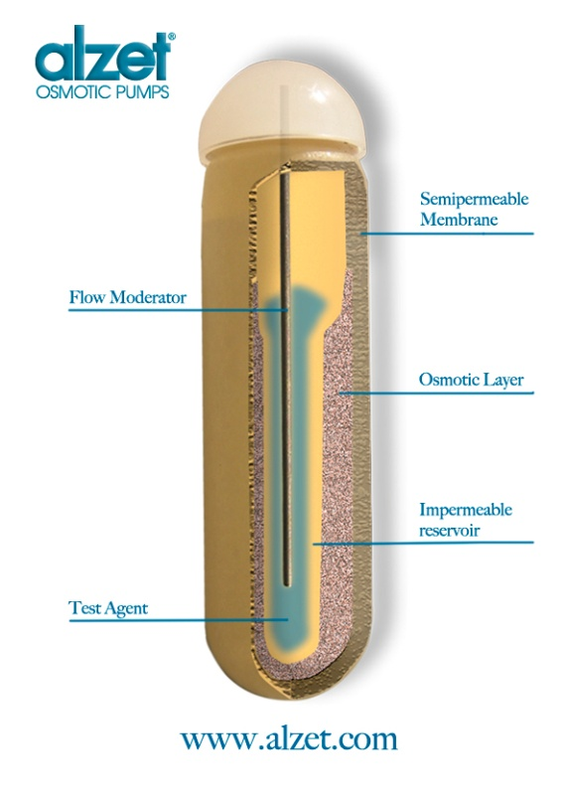
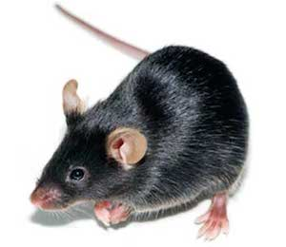
Methods
β2 KO
α7 KO
WT
1. Nicotine (6.3 mg/kg/day)
2. Saline
After 12 Days – Pump Removed

Slide 32
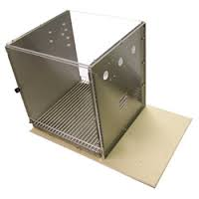
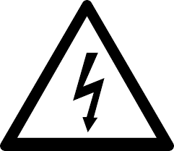
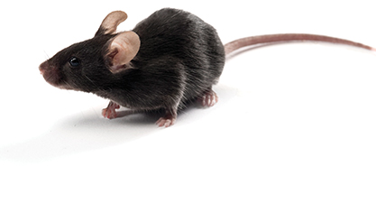
Methods
120 s baseline
35 s CS (85 dB)
2 s footshock (0.57 mA)
120 s ITI
35 s CS
2 s footshock
30 s
1. Freezing scored for 5 min
Training and Testing (Days 13 & 14)
Plexiglas
Plexiglas
Stainless Steel
Stainless Steel
Plexiglas
24 Hours...

Slide 33
Methods
One hour…

Slide 34
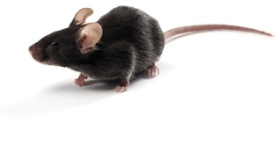
Methods
Testing Freezing
3 min (no CS)
3 min CS (85 dB)
Plexiglas
Plexiglas
Aluminum
Aluminum
Plexiglas

Slide 35
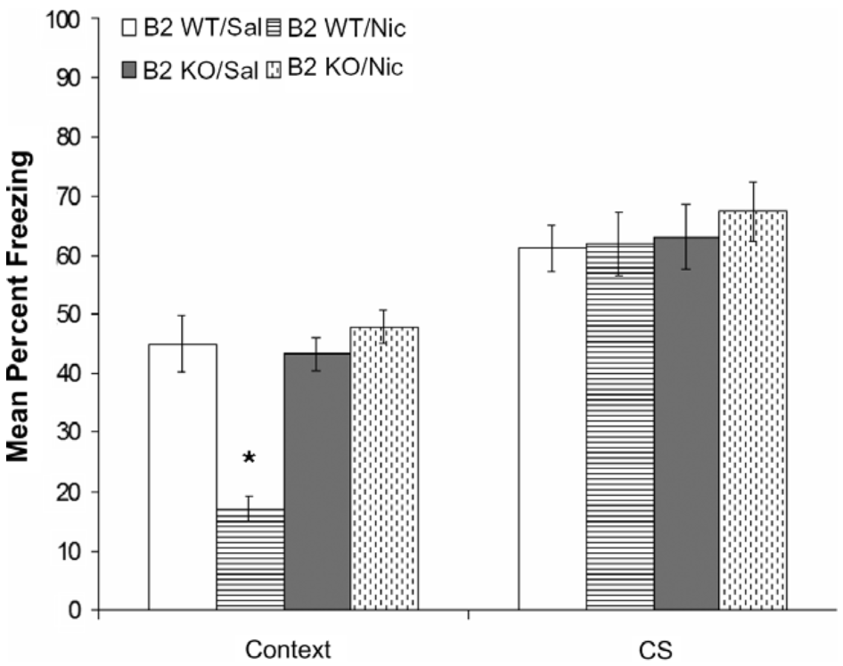
Results
β2 subunit responsible for contextual fear learning deficits following nicotine withdrawal?
P < 0.05

Slide 36
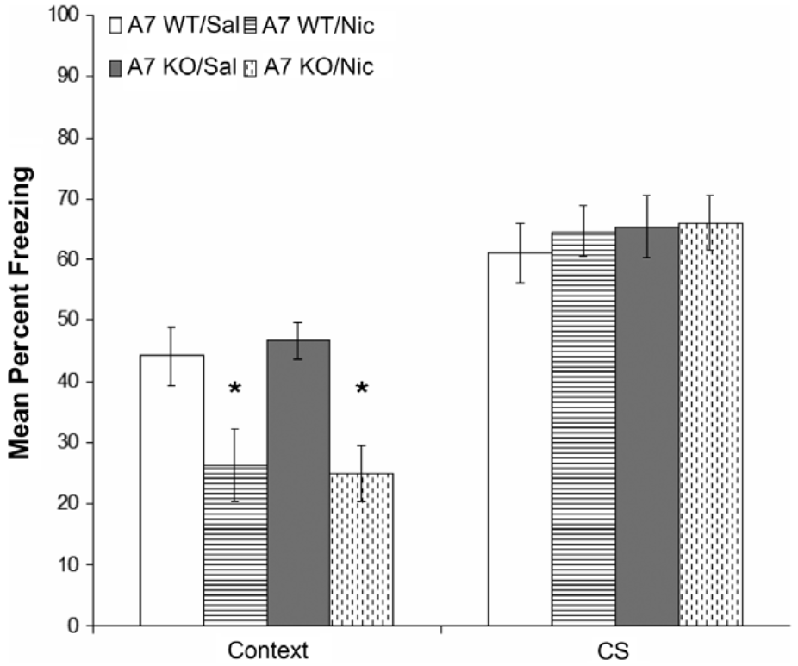
Results
α7 subunit not responsible for learning deficits following nicotine withdrawal?
P < 0.05
P < 0.05

Slide 37
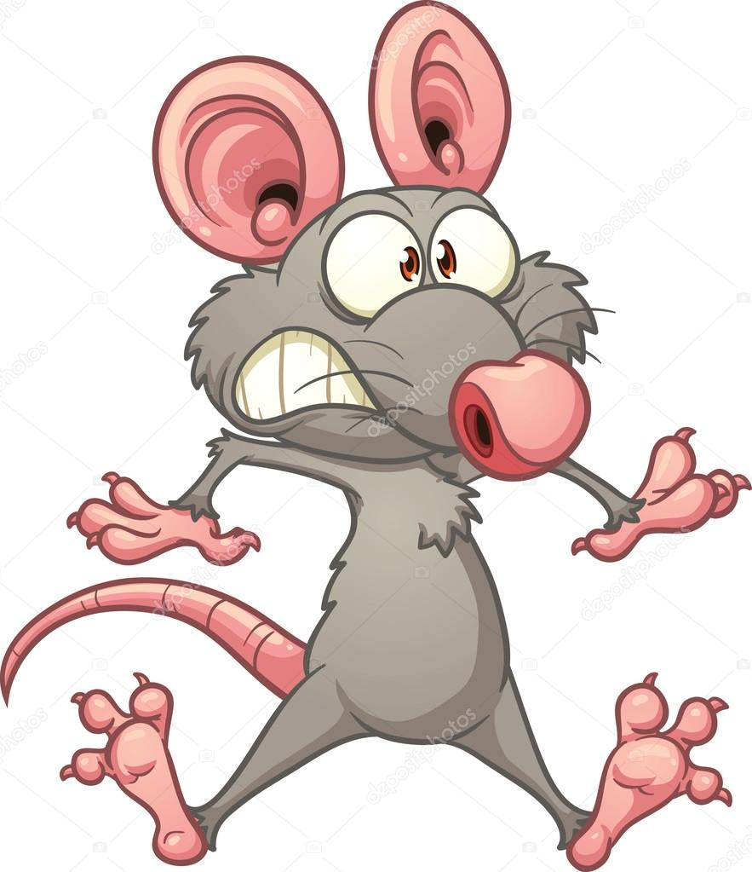
So…
β2 subunit is playing a role in contextual fear learning deficits during nicotine withdrawal
But…
Is recollection of the learning impacted?

Slide 38
Methods
WT
1. Nicotine (6.3 mg/kg/day)
2. Saline
After 12 Days – Pump Removed

Slide 39
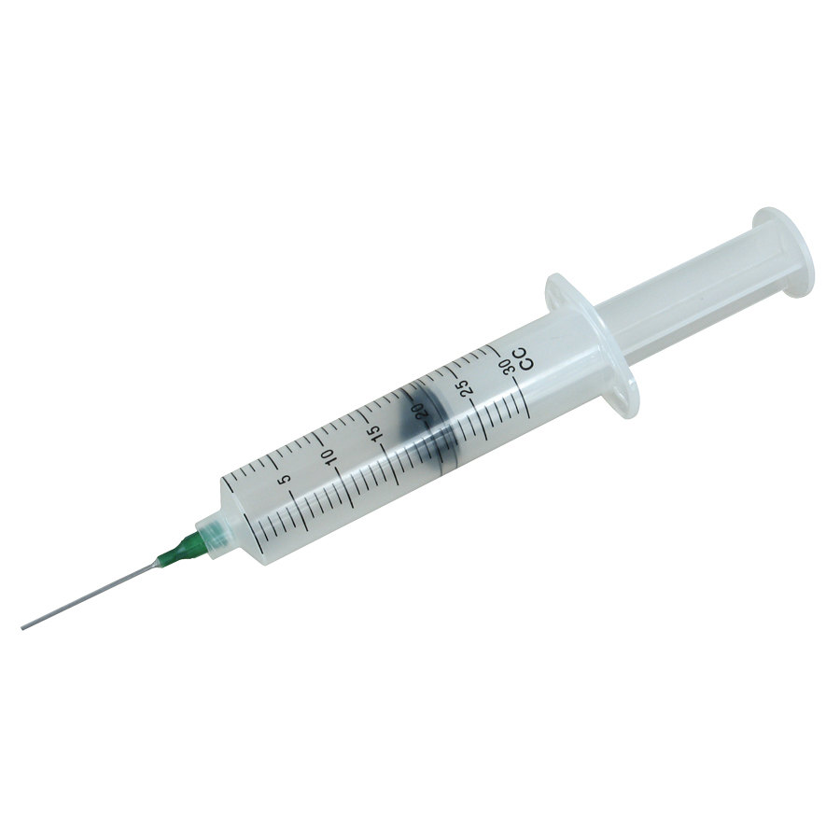
Methods
Day 13 – 25 min before Training
Or
Day 14 – 25 min before Training
DHβE (3.0 mg/kg)
Saline

Slide 40
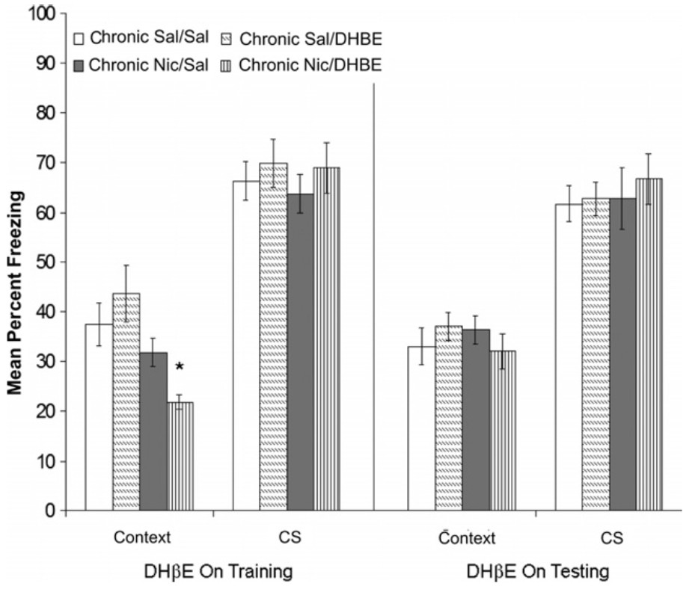
Results
nAChR blockade disrupts contextual fear learning, but not recall?
P < 0.05

Slide 41
Methods
WT
1. Nicotine (6.3 mg/kg/day)
2. Saline
After 12 Days – Pump Removed

Slide 42
Methods
Day 13 – 25 min before Training
AND
Day 14 – 25 min before Training
DHβE (3.0 mg/kg)
Saline

Slide 43
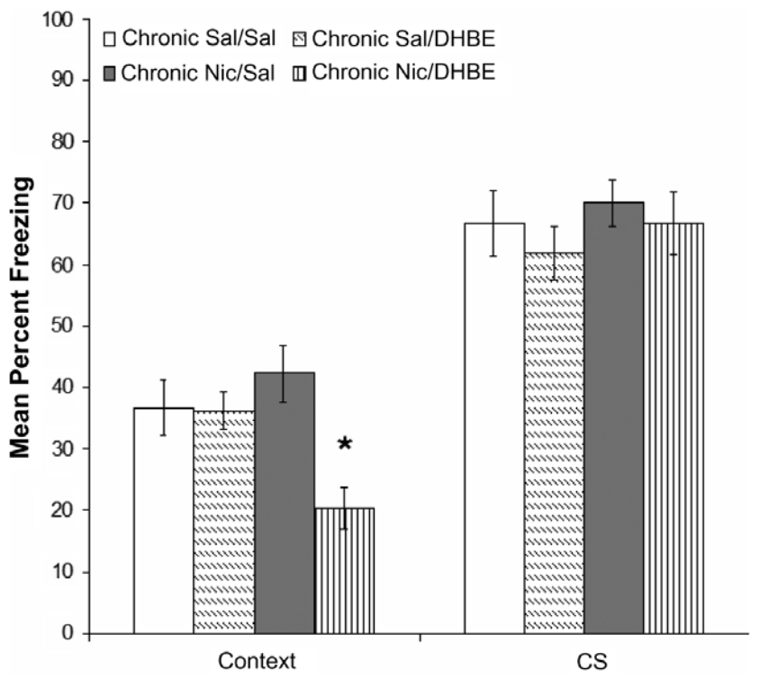
Results
nAChR blockade disrupts contextual fear learning, but not recall?
P < 0.05

Slide 44
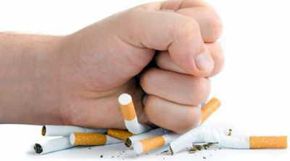
So…
β2 subunits on nAChRs are involved in learning deficits associated with nicotine withdrawal
And…
Orexin could potentially be involved
But…
Where does social stress resilience fit in?
And…
Where might the nAChR/orexin action be taking place?

Slide 45
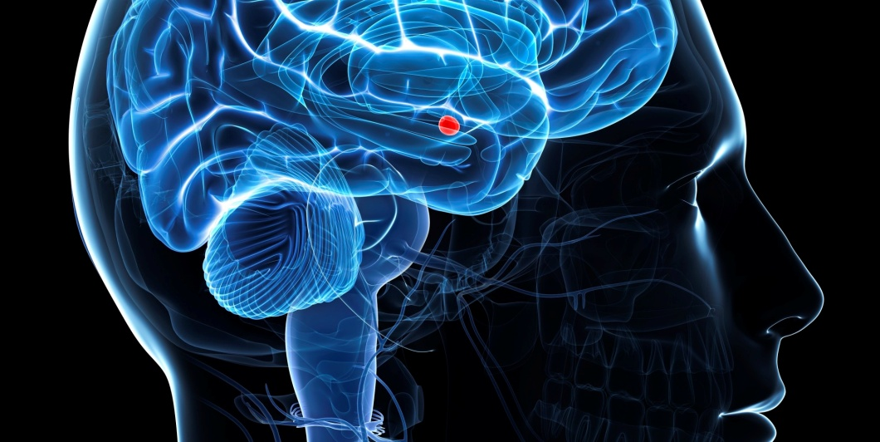
Multiple nicotinic acetylcholine receptor subtypes in the mouse amygdala regulate affective behaviors and response to social stress
Mineur et al.

Slide 46
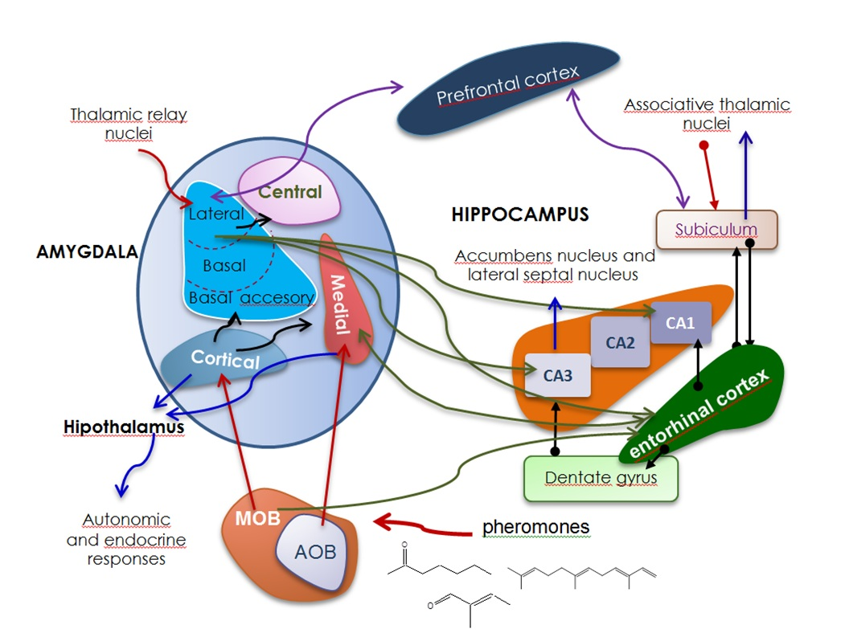
A brief introduction to the complex amygdala
Important in:
Decision-Making
Memory
Emotional Interpretation, Expression, & Response

Slide 47
Depression/Anxiety & ACh
Increased brain ACh is associated with depression^{1,2}
Blocking mAChRs or nAChRs can produce antidepressant effects³
In humans, whole brain blockade of AChRs is maybe not viable⁴
Perhaps targeting specific receptor subunits?
BLA is hyperactivated during depressive states⁵ and ACh signaling may be involved when nicotine is present⁶
1. Hannestad, J. O., et al. (2013). "Changes in the cholinergic system between bipolar depression and euthymia as measured with [123 I] 5IA single photon emission computed tomography." Biological psychiatry 74(10): 768-776.
2. Risch, S. C., et al. (1981). "Cholinergic challenges in affective illness: behavioral and neuroendocrine correlates." Journal of clinical psychopharmacology 1(4): 186-192.
3. Mineur, Y. S., et al. (2013). "Cholinergic signaling in the hippocampus regulates social stress resilience and anxiety-and depression-like behavior." Proceedings of the National Academy of Sciences 110(9): 3573-3578.
4. Vieta, E., et al. (2014). "Efficacy and tolerability of flexibly-dosed adjunct TC-5214 (dexmecamylamine) in patients with major depressive disorder and inadequate response to prior antidepressant." European Neuropsychopharmacology 24(4): 564-574.
5. Drevets, W. C., et al. (2008). "Brain structural and functional abnormalities in mood disorders: implications for neurocircuitry models of depression." Brain structure and function 213(1-2): 93-118.
6. Jiang, L. and L. W. Role (2008). "Facilitation of cortico–amygdala synapses by nicotine: activity-dependent modulation of glutamatergic transmission." Journal of neurophysiology 99(4): 1988-1999.

Slide 48
Methods
Mecamylamine (2 μg/ml)
Vehicle
RECOVERY PERIOD

Slide 49
Methods
30 min after infusion
6 min

Slide 50
Results
nACHR blockade in the amygdala reduces anxious/depressive behaviors?
P < 0.01

Slide 51
Methods

Slide 52
Methods
Adeno-associated viral knockdown (AAV-shRNA)
β2 RNA subunit Knockdown
α7 RNA subunit Knockdown
Scrambled AAV-shRNA

Slide 53
Methods
~5 weeks later…
6 min

Slide 54
Results
β2 KD in the amygdala reduces anxious behaviors?
P < 0.05

Slide 55
Results
α7 KD in the amygdala reduces anxious behaviors?
P < 0.001

Slide 56
Methods
Still KD Mice…~5 weeks after AAV-shRNA administration
6 min

Slide 57
Results
β2 KD in the amygdala reduces anxious/depressive behaviors?
P < 0.001

Slide 58
Results
α7 KD in the amygdala reduces anxious/depressive behaviors?
P < 0.05

Slide 59
Results
β2 & α7 KD in the amygdala obstruct the antidepressant effects of systemic mecamylamine?
P < 0.001
P < 0.001
Systemic (1.0 mg/kg)

Slide 60
Results
β2 & α7 KD in the amygdala partially reduces depressive effects of systemic increases in ACh?
P < 0.05
P < 0.001
P < 0.001
P < 0.001
Systemic (1.5 mg/kg)

Slide 61
Methods
Still KD Mice…~5 weeks after AAV-shRNA administration
15 min

Slide 62
Results
β2 & α7 KD in the amygdala reduce neuronal activity in the BLA?
P < 0.001
P < 0.06
Following 15 min FST

Slide 63
Results
β2 KD in the amygdala reduces behavioral despair?
P < 0.05

Slide 64
Results
α7 KD in the amygdala does not reduce behavioral despair?

Slide 65
Results
β2 & α7 KD in the amygdala partially counteract despair induction through increasing systemic ACh?
P < 0.007
P < 0.007
P < 0.001
P < 0.001
Systemic (1.5 mg/kg)

Slide 66
So…
α7- & β2-containing nAChRs in the amygdala ↑ neuronal activity in the BLA and create…
1) Anxious Behaviors
2) Depressive Behaviors
3) Behavioral Despair
But…
How are social behaviors affected?

Slide 67
Methods
Still KD Mice…~5 weeks after AAV-shRNA administration
This is MY house!
2x a day for 3 days – New CD-1 each day
10 min

Slide 68
Methods
Day 4
(Time near box with aggressor/Time near empty box) x 100
≥100 = Resilient <100 = Susceptible

Slide 69
Results
β2 KD in the amygdala increases social stress resilience?
P < 0.001

Slide 70
Results
α7 KD in the amygdala does not affect social stress resilience?

Slide 71
Results
β2 KD in the amygdala with systemic nACh blockade significantly increases social stress susceptibilty?
P < 0.01
P < 0.05
Systemic (1.0 mg/kg)

Slide 72
So…
β2-containing nAChRs may partially explain the social stress impairments that stem from ↑ BLA activity
However, this is not the full story
But…
Brain nAChRs appear to be important…
And…
BLA activity appears to be important…
Can we tie in orexin?

Slide 73
Filling some gaps…
Orexinergic cells project to the amygdala¹ and the amygdala projects back to orexin-containing cells²
Nicotine exposure in utero ↑ orexinergic cells and ↑ orexin in the amygdala³
Smoking while pregnant is associated to child behavioral deficits:
1) ADHD⁴
2) Addictive tendencies⁵
3) Antisocial behaviors^{6,7}
1. Peyron, C., et al. (1998). "Neurons containing hypocretin (orexin) project to multiple neuronal systems." Journal of Neuroscience 18(23): 9996-10015.
2. Sakurai, T., et al. (2005). "Input of orexin/hypocretin neurons revealed by a genetically encoded tracer in mice." Neuron 46(2): 297-308.
3. Chang, G.Q., et al. (2013). "Prenatal exposure to nicotine stimulates neurogenesis of orexigenic peptide-expressing neurons in hypothalamus and amygdala." Journal of Neuroscience 33(34): 13600-13611.
4. Rodriguez, A. and G. Bohlin (2005). "Are maternal smoking and stress during pregnancy related to ADHD symptoms in children?" Journal of child psychology and psychiatry 46(3): 246-254.
5. Ernst, M., et al. (2001). "Behavioral and neural consequences of prenatal exposure to nicotine." Journal of the American Academy of Child & Adolescent Psychiatry 40(6): 630-641.
6. Weissman, M. M., et al. (1999). "Maternal Smoking During Pregnancy and Psychopathology in Offspring Followed to Adulthood." Journal of the American Academy of Child & Adolescent Psychiatry 38(7): 892-899.
7. Wakschlag, L. S., et al. (2002). "Maternal smoking during pregnancy and severe antisocial behavior in offspring: a review." American journal of public health 92(6): 966-974.

Slide 74
Bringing Everything Together
Nicotine → ↑ Orexinergic Activity → ↑ Anxiety
Nicotine → ↑ β2 nAChR Activity → ↓ Contextual Fear Learning
↑ α7 & β2 nAChR Activity in Amygdala → ↑ BLA Activity → ↑Anxiety/Depression/Despair
↑ β2 nAChR Activity in Amygdala → ↑ BLA Activity → ↑Social Stress

Slide 75
Bringing Everything Together
Glu
Orx
ACh
?

Slide 76
Bringing Everything Together
Orx
Orx
Orx
Orx
Orx
ADHD
Addictive Personality
Antisocial Behaviors
?

Slide 77
Bringing Everything Together
?

Slide 78
Bringing Everything Together

Slide 79
Bringing Everything Together
What if….
Orexin
And….
β2 nAChR activation

Slide 80
Bringing Everything Together
How might this work?
β2 nAChR
Orx
ACh

Slide 81
Bringing Everything Together
How might this work?
Orx
OrxR
ACh
β2 nAChR
Amygdala

Slide 82
Bringing Everything Together
= β2 nAChR
nucleus accumbens
nucleus basalis
diagonal band of Broca
substantia innominata
medial septal nucleus
LH Area
Basal Forebrain
Amygdala
Septohippocampal Area
PPT/LDT

Slide 83
Bringing Everything Together
Not everything…
Remember, reward circuit is also involved
And…
The amygdala has several divisions with independent functions
Orx₂Rs in BLA appear to play an anxiolytic role¹
1. Arendt, D. H., et al. (2014). "Anxiolytic function of the orexin 2/hypocretin A receptor in the basolateral amygdala." Psychoneuroendocrinology 40: 17-26.

Slide 84
Conclusions
Nicotine can produce anxiogenic responses
β2 subunit contributes to anxious behaviors, contextual fear learning, and social stress susceptibility
Orexinergic and cholinergic systems are largely intertwined
The amygdala is important for social stress

Slide 85
References
Arendt, D. H., et al. (2014). "Anxiolytic function of the orexin 2/hypocretin A receptor in the basolateral amygdala." Psychoneuroendocrinology 40: 17-26.
Aston-Jones, G., et al. (2009). "Role of lateral hypothalamic orexin neurons in reward processing and addiction." Neuropharmacology 56: 112-121
Bertone, E. R., et al. (2002). "Environmental tobacco smoke and risk of malignant lymphoma in pet cats." Am J Epidemiol 156(3): 268-273.
Breslau, N., et al. (1996). "Sleep disturbance and psychiatric disorders: a longitudinal epidemiological study of young adults." Biological psychiatry 39(6): 411-418.
Carbone, D. (1992). "Smoking and cancer." The American journal of medicine 93(1): S13-S17.
Chang, G.Q., et al. (2013). "Prenatal exposure to nicotine stimulates neurogenesis of orexigenic peptide-expressing neurons in hypothalamus and amygdala." Journal of Neuroscience 33(34): 13600-13611.
Changeux, J.-P. (2010). "Nicotine addiction and nicotinic receptors: lessons from genetically modified mice." Nat Rev Neurosci 11(6): 389-401.
Drevets, W. C., et al. (2008). "Brain structural and functional abnormalities in mood disorders: implications for neurocircuitry models of depression." Brain structure and function 213(1-2): 93-118.
Eggermann, E., et al. (2001). "Orexins/hypocretins excite basal forebrain cholinergic neurones." Neuroscience 108(2): 177-181.
Ernst, M., et al. (2001). "Behavioral and neural consequences of prenatal exposure to nicotine." Journal of the American Academy of Child & Adolescent Psychiatry 40(6): 630-641.
Gotter, A. L., et al. (2012). "International Union of Basic and Clinical Pharmacology. LXXXVI. Orexin receptor function, nomenclature and pharmacology." Pharmacological reviews 64(3): 389-420.
Hagan, J. J., et al. (1999). "Orexin A activates locus coeruleus cell firing and increases arousal in the rat." Proceedings of the National Academy of Sciences 96(19): 10911-10916.
Hannestad, J. O., et al. (2013). "Changes in the cholinergic system between bipolar depression and euthymia as measured with [123 I] 5IA single photon emission computed tomography." Biological psychiatry 74(10): 768-776.
Holland, P. and P. J. Goadsby (2007). "The hypothalamic orexinergic system: pain and primary headaches." Headache: The Journal of Head and Face Pain 47(6): 951-962.
Irvine, E. E., et al. (2001). "Development of tolerance to nicotine’s anxiogenic effect in the social interaction test." Brain research 894(1): 95-100.
Jiang, L. and L. W. Role (2008). "Facilitation of cortico–amygdala synapses by nicotine: activity-dependent modulation of glutamatergic transmission." Journal of neurophysiology 99(4): 1988-1999.
Johnson, P. L., et al. (2010). "A key role for orexin in panic anxiety." Nature medicine 16(1): 111-115.
Kiyashchenko, L. I., et al. (2002). "Release of hypocretin (orexin) during waking and sleep states." The journal of neuroscience 22(13): 5282-5286.
Kotz, C., et al. (2012). "Brain orexin promotes obesity resistance." Annals of the New York Academy of Sciences 1264(1): 72-86.
Leckman, J. F., et al. (1984). "Appetite disturbance and excessive guilt in major depression: use of family study data to define depressive subtypes." Archives of general psychiatry 41(9): 839-844.
Mineur, Y. S., et al. (2013). "Cholinergic signaling in the hippocampus regulates social stress resilience and anxiety-and depression-like behavior." Proceedings of the National Academy of Sciences 110(9): 3573-3578.
Mineur, Y. S., et al. (2016). "Multiple Nicotinic Acetylcholine Receptor Subtypes in the Mouse Amygdala Regulate Affective Behaviors and Response to Social Stress." Neuropsychopharmacology 41(6): 1579-1587.
Parrott, A. C. (1999). "Does cigarette smoking cause stress?" American Psychologist 54(10): 817.
Pasumarthi, R. K. and J. Fadel (2010). "Stimulation of lateral hypothalamic glutamate and acetylcholine efflux by nicotine: implications for mechanisms of nicotine‐induced activation of orexin neurons." Journal of neurochemistry Reif, J. S., et al. (1992). "Passive smoking and canine lung cancer risk." Am J Epidemiol 135(3): 234-239.
Plaza-Zabala, A., et al. (2010). "Hypocretins regulate the anxiogenic-like effects of nicotine and induce reinstatement of nicotine-seeking behavior." Journal of Neuroscience 30(6): 2300-2310.113(4): 1023-1035.
Portugal, G. S., et al. (2008). "β2 subunit containing acetylcholine receptors mediate nicotine withdrawal deficits in the acquisition of contextual fear conditioning." Neurobiology of learning and memory 89(2): 106-113.
Reitsma, M. B., et al. "Smoking prevalence and attributable disease burden in 195 countries and territories, 1990&#x2013;2015: a systematic analysis from the Global Burden of Disease Study 2015." The Lancet 389(10082): 1885-1906.
Risch, S. C., et al. (1981). "Cholinergic challenges in affective illness: behavioral and neuroendocrine correlates." Journal of clinical psychopharmacology 1(4): 186-192.
Rodriguez, A. and G. Bohlin (2005). "Are maternal smoking and stress during pregnancy related to ADHD symptoms in children?" Journal of child psychology and psychiatry 46(3): 246-254.
Sakurai, T., et al. (1998). "Orexins and orexin receptors: a family of hypothalamic neuropeptides and G protein-coupled receptors that regulate feeding behavior." Cell 92(4): 573-585.
Sakurai, T., et al. (2005). "Input of orexin/hypocretin neurons revealed by a genetically encoded tracer in mice." Neuron 46(2): 297-308.
Sakurai, T. (2007). "The neural circuit of orexin (hypocretin): maintaining sleep and wakefulness." Nature Reviews Neuroscience 8(3): 171-181.
Siegel, J., et al. (2001). "A brief history of hypocretin/orexin and narcolepsy." Neuropsychopharmacology 25(5): S14-S20.
Tovote, P., et al. (2015). "Neuronal circuits for fear and anxiety." Nature Reviews. Neuroscience 16(6): 317.
Vieta, E., et al. (2014). "Efficacy and tolerability of flexibly-dosed adjunct TC-5214 (dexmecamylamine) in patients with major depressive disorder and inadequate response to prior antidepressant." European Neuropsychopharmacology 24(4): 564-574.
Villanti, A. C., et al. (2017). "Identifying “social smoking” US young adults using an empirically-driven approach." Addictive Behaviors 70: 83-89.
Wakschlag, L. S., et al. (2002). "Maternal smoking during pregnancy and severe antisocial behavior in offspring: a review." American journal of public health 92(6): 966-974.
Wess, J., et al. (2007). "Muscarinic acetylcholine receptors: mutant mice provide new insights for drug development." Nat Rev Drug Discov 6(9): 721-733.
Weissman, M. M., et al. (1999). "Maternal Smoking During Pregnancy and Psychopathology in Offspring Followed to Adulthood." Journal of the American Academy of Child & Adolescent Psychiatry 38(7): 892-899.
Winsky-Sommerer, R., et al. (2004). "Interaction between the corticotropin-releasing factor system and hypocretins (orexins): a novel circuit mediating stress response." Journal of Neuroscience 24(50): 11439-11448.
Wu, M., et al. (2004). "Hypocretin/orexin innervation and excitation of identified septohippocampal cholinergic neurons." Journal of Neuroscience 24(14): 3527-3536.
Yamanaka, A., et al. (2003). "Regulation of orexin neurons by the monoaminergic and cholinergic systems." Biochemical and Biophysical Research Communications 303(1): 120-129.

